Slide 1
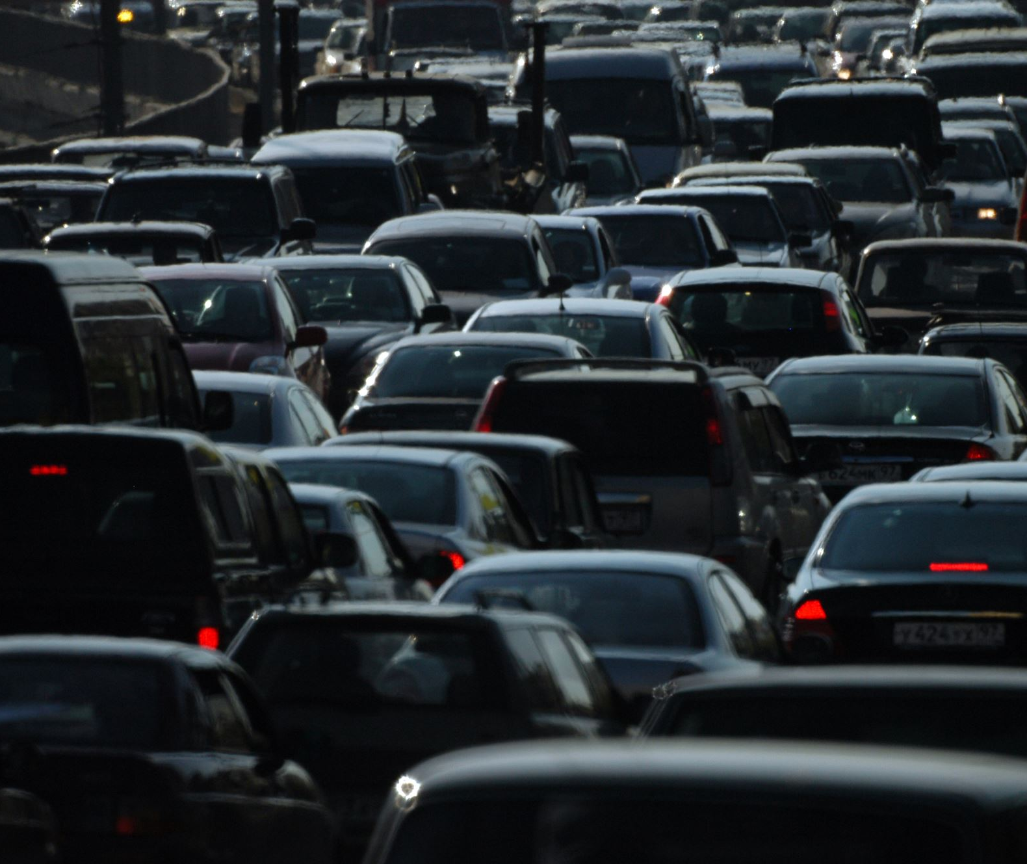
Analysis of Car Accidents In USA Lior Ben David Sahar Ziv

Slide 2
מבנה הנתונים
הנתונים נאספו בשנת 2018 וכוללים שלושה קבצים:
Datasets | מספר רשומות | מספר פיצ'רים
נתוני התאונה | 48443 | 51
נתוני האנשים שהשתתפו בתאונה | 120230 | 54
נתוני הרכבים שהשתתפו בתאונה | 86105 | 87
השדה שמקשר בין כל הטבלאות הוא ‘CASENUM’שמייצג את מספר התאונה.
קיימות עמודות כפולות בין הטבלאות השונות.
נשלב את כל הטבלאות לאחת לפי המפתח.
נרצה לנבא את חומרת הפציעה של נהג בתאונה לפי נתוני האדם, הרכב, מזג האוויר ותנאי הדרך.
מספר רשומות | מספר פיצ'רים
120230 | 192

Slide 3
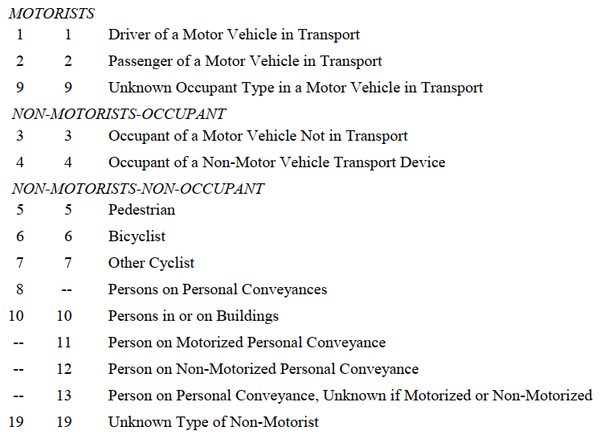
Clean The Data
Filter the drivers
Filter drivers
Merge tables
Handling NaN
Imputation
Dropping Features
Filter from the person table only the drivers by PER_TYP = 1
מספר רשומות | מספר פיצ'רים
85916 | 192

Slide 4
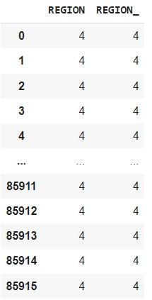
Clean The Data
Merge the tables
Filter drivers
Merge tables
Handling NaN
Imputation
Dropping Features
We merged the drivers and the vehicles tables by "CASENUM","VEH_NO" and then we merged the new table with the accidents table by "CASENUM".
The merge caused duplicate columns, so we drop it.
מספר רשומות | מספר פיצ'רים
85916 | 150

Slide 5
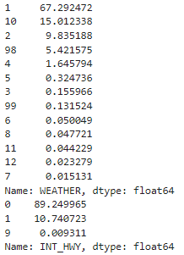
Clean The Data
Handling missing values
Filter drivers
Merge tables
Handling NaN
Imputation
Dropping Features
We checked if there are any null values, and there was not.
so, we checked the distribution of each feature.
מספר רשומות | מספר פיצ'רים
85916 | 150

Slide 6
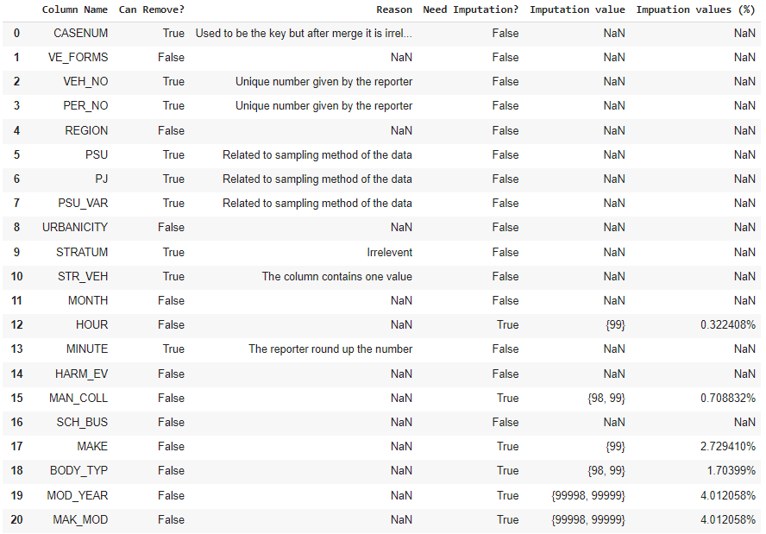
Clean The Data
Summarize Column Decisions
Filter drivers
Merge tables
Handling NaN
Imputation
Dropping Features
In this table we summarized all the 150 features we have and decided what to do with each one.
מספר רשומות | מספר פיצ'רים
85916 | 150

Slide 7
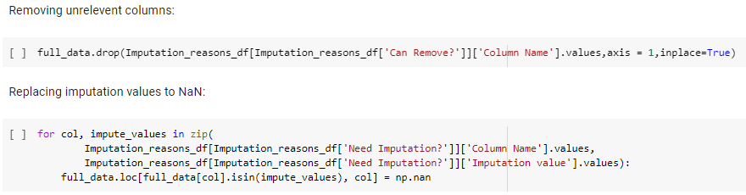
Clean The Data
Summarize Column Decisions
Filter drivers
Merge tables
Handling NaN
Imputation
Dropping Features
We drop the features that we decided to drop and changed the values we want to impute to NaN to prepare them to imputation.
To impute the missing values, we use KNN imputer with 1 nearest neighbor.
מספר רשומות | מספר פיצ'רים
85916 | 40

Slide 8
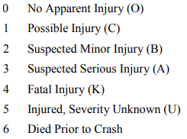
Clean The Data
Aggregate The Label
Filter drivers
Merge tables
Handling NaN
Imputation
Dropping Features
We decided to aggregate the label to two groups:
0 – No injury or minor injury
1 – Severe injury or fatal
מספר רשומות | מספר פיצ'רים
85916 | 40

Slide 9
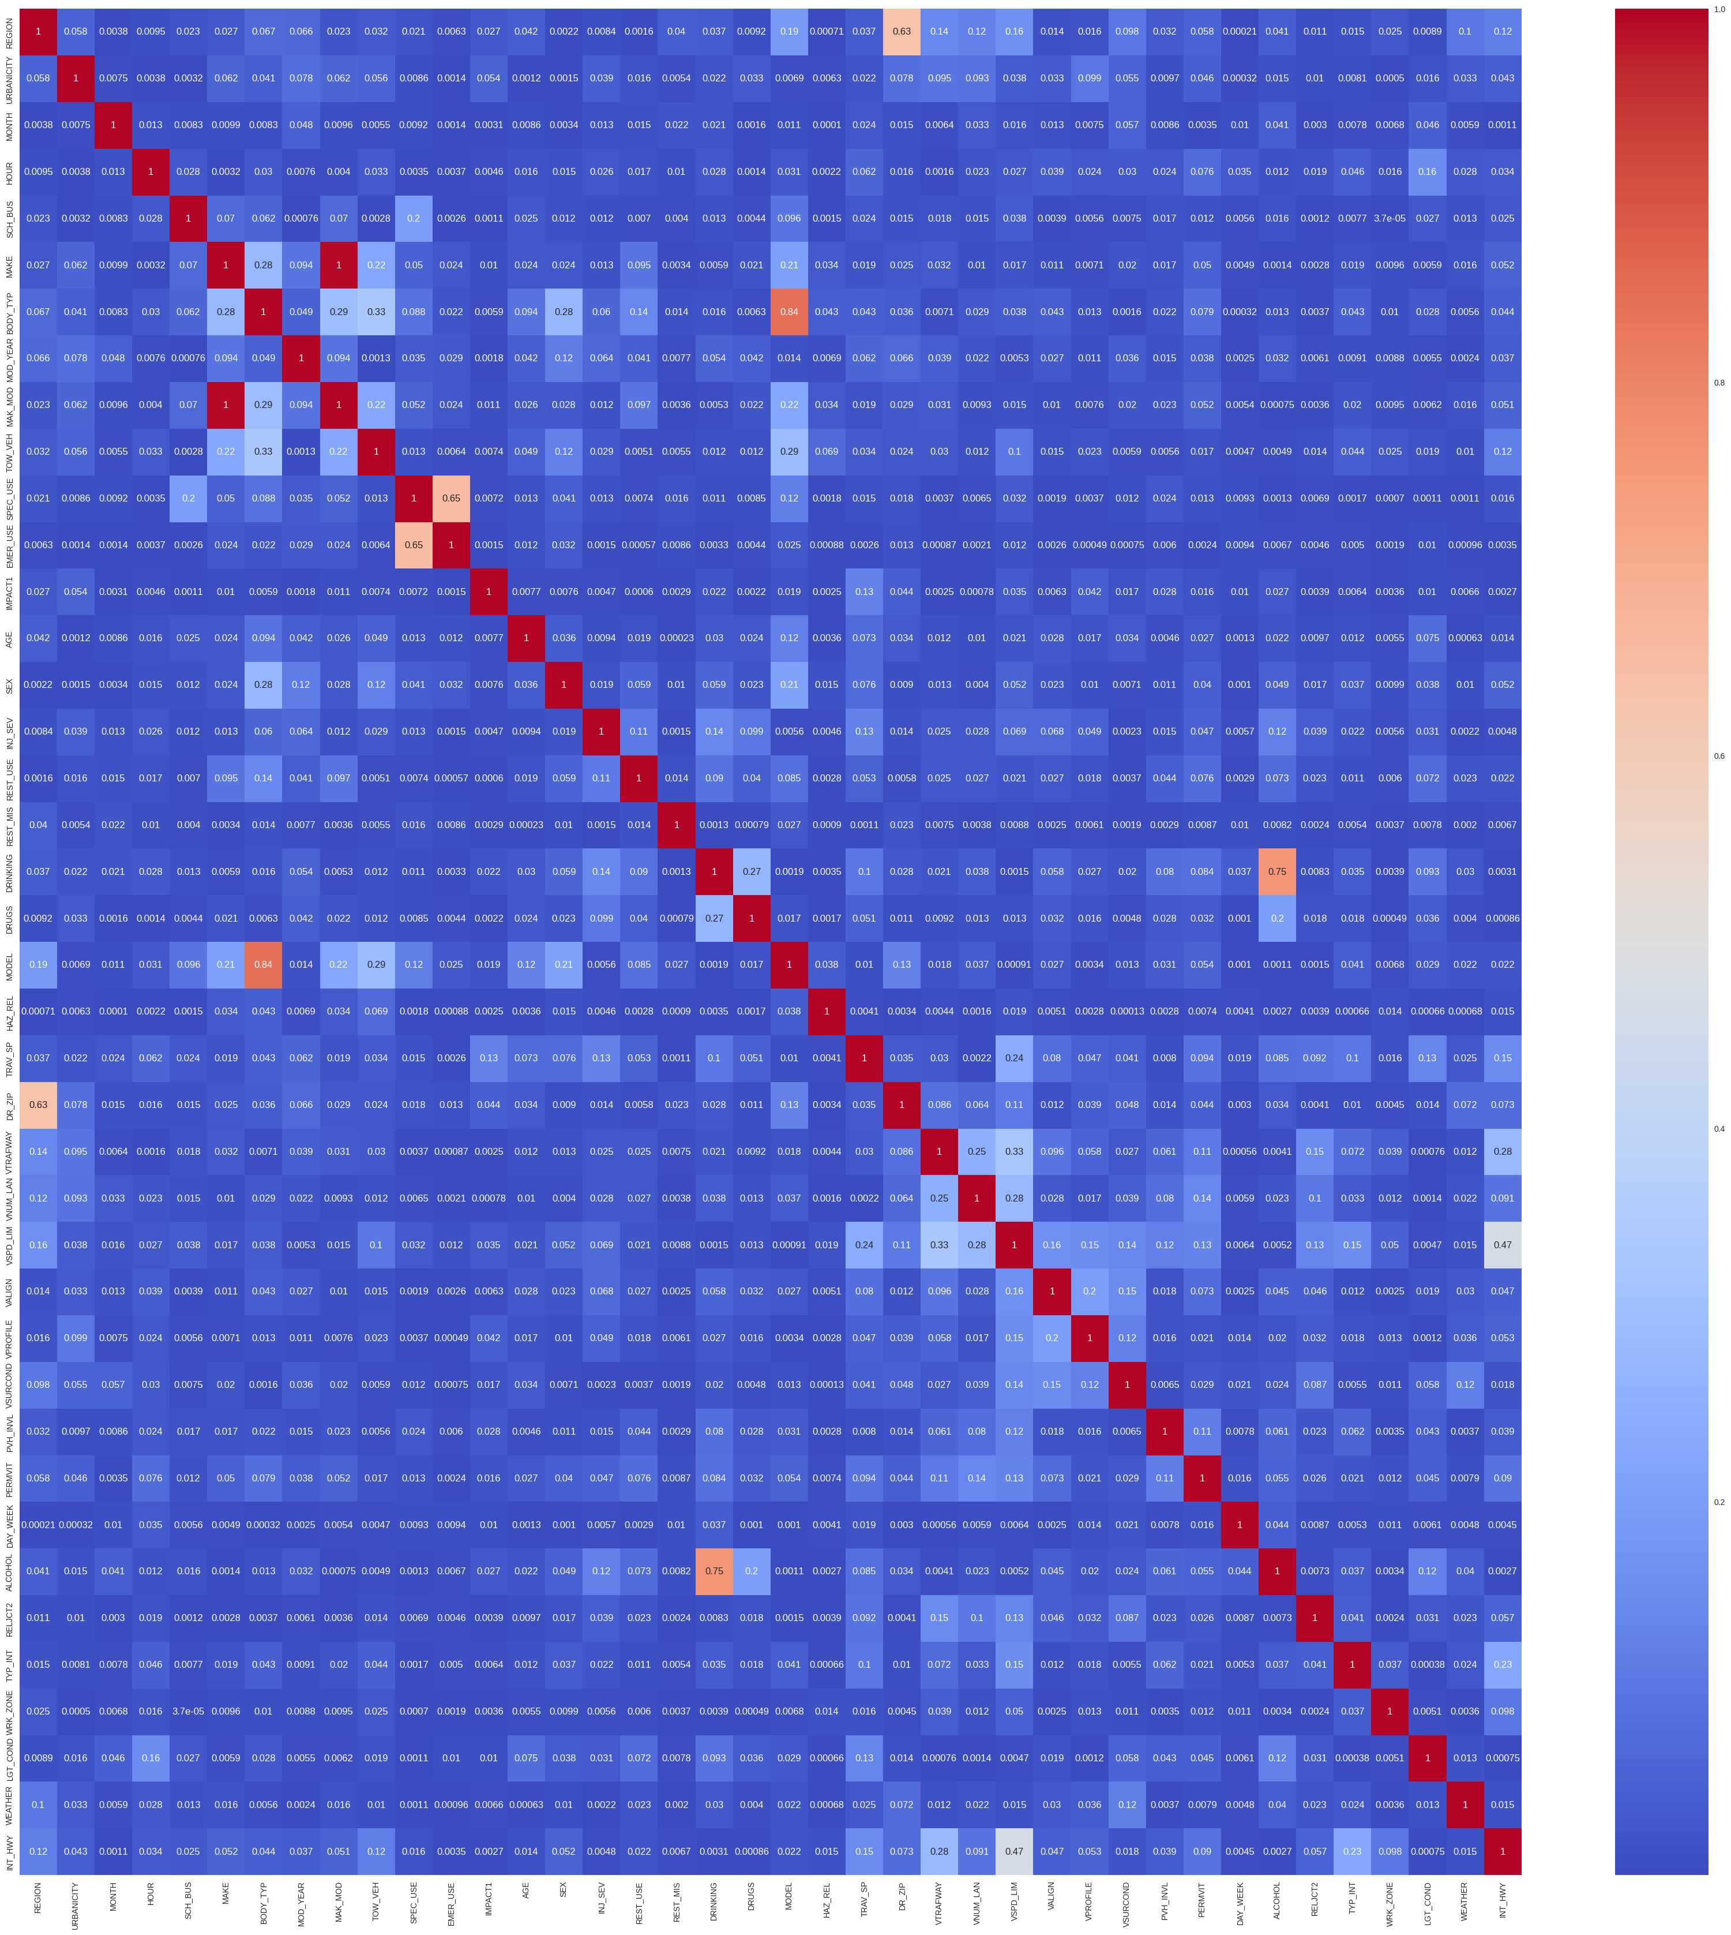
Clean The Data
Correlation Between Features
Filter drivers
Merge tables
Handling NaN
Imputation
Dropping Features
The high correlation is between the pairs:
Region – DR_ZIP
MAKE – MAK_MOD
BODY_TYP – MODEL
SPEC_USE – EMER_USE
DRINKING – ALCOHOL
We decided to remove the columns:
DR_ZIP, MAK_MOD, BODY_TYP, EMER_USE, ALCOHOL
מספר רשומות | מספר פיצ'רים
85916 | 35

Slide 10
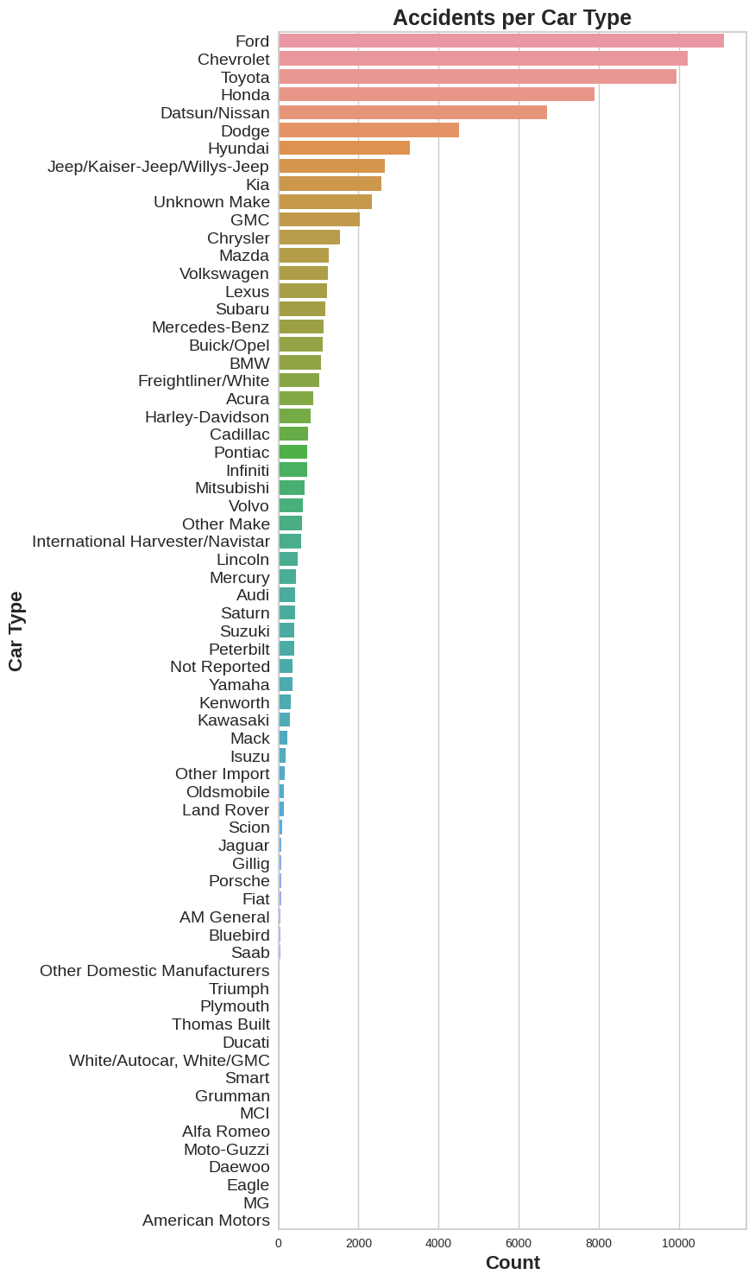
Clean The Data
Biased Data
Filter drivers
Merge tables
Handling NaN
Imputation
Dropping Features
At the first presentation we presented the number of accidents per maker, and we could see that the number of accidents is higher to American manufacturers than Non-American manufacturers.
It makes sense because our data is sampled from USA, and it makes a choosing bias and can cause wrong conclusions.
Therefore, we decided to remove the features MAKE and MODEL.
מספר רשומות | מספר פיצ'רים
85916 | 33

Slide 11
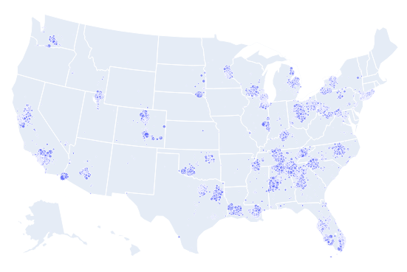
Clean The Data
Biased Data
Filter drivers
Merge tables
Handling NaN
Imputation
Dropping Features
We can see that we have choosing bias in our data, we can see that there are states that weren’t sampled.
מספר רשומות | מספר פיצ'רים
85916 | 33

Slide 12
Pre-Processing Steps
Split the data to Train set and Test set
(70%-30%)
Scaling (fit the scaler on the train set and transform both train and test)
One-Hot Encoding (both train and test)
Over Sampling using SMOTE (only the train set)
Feature selection using LASSO
מספר רשומות Test | מספר רשומות Train | מספר פיצ'רים
25775 | 113370 | 84
Notes:
least absolute shrinkage and selection operator
לאסו: $\min\left\{\sum^{N}{{\left(y_{i}−β_{0}−x_{i}^{T}β\right)}^{2}}+λ⋅\sum^{p}{\left|β_{j}\right|}\right\}$
בסוף ה-Label מאוזן

Slide 13
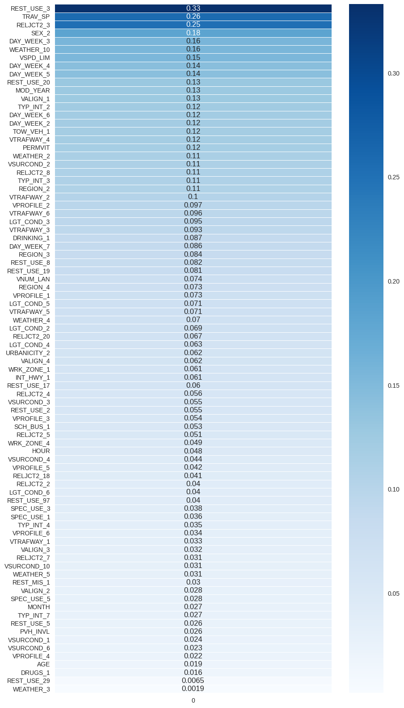
Feasibility of the project
In our analysis we would try to classify if the driver involved in road accidents will be injured or not, with the help of personal data, vehicle data, weather and road data.
We can see the correlation of the features with the label

Slide 14
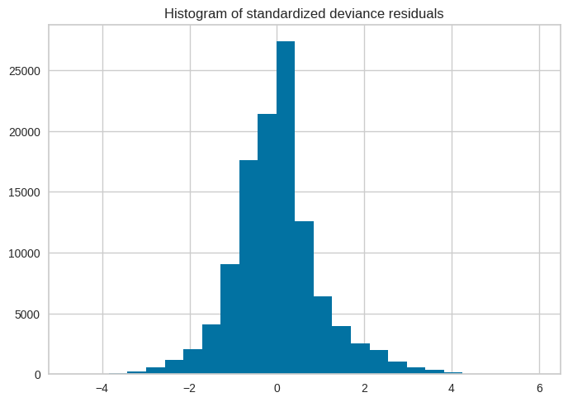
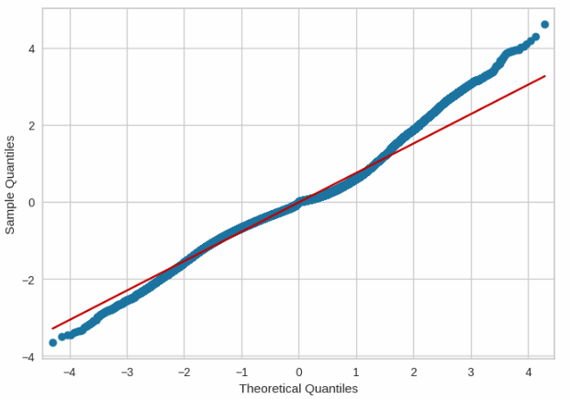

Outlier Detection
We fitted Logistic Regression model: $P\left(Y=1 | X\right)=\frac{e^{β⋅X}}{1+e^{β⋅X}}$

Slide 15
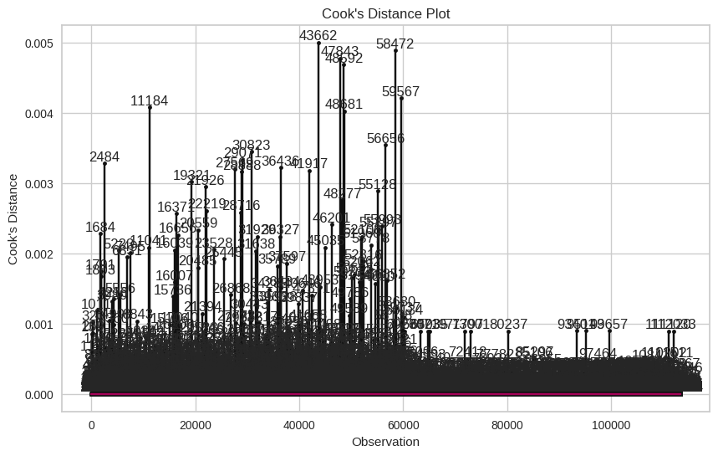
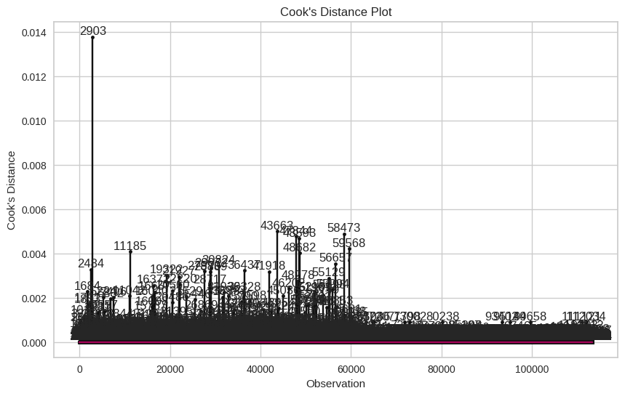


Slide 16
Previous Presentation
Vehicles – ratio of the vehicle in the population – We removed the feature MAKE because it made the data imbalanced.
Unbalanced Data – We Over-Sampled the data with SMOTE to make the label balanced.
Is the data will answer the question? Yes, we can see the feasibility of the project and the models predication is pretty good.

Slide 17

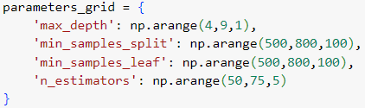
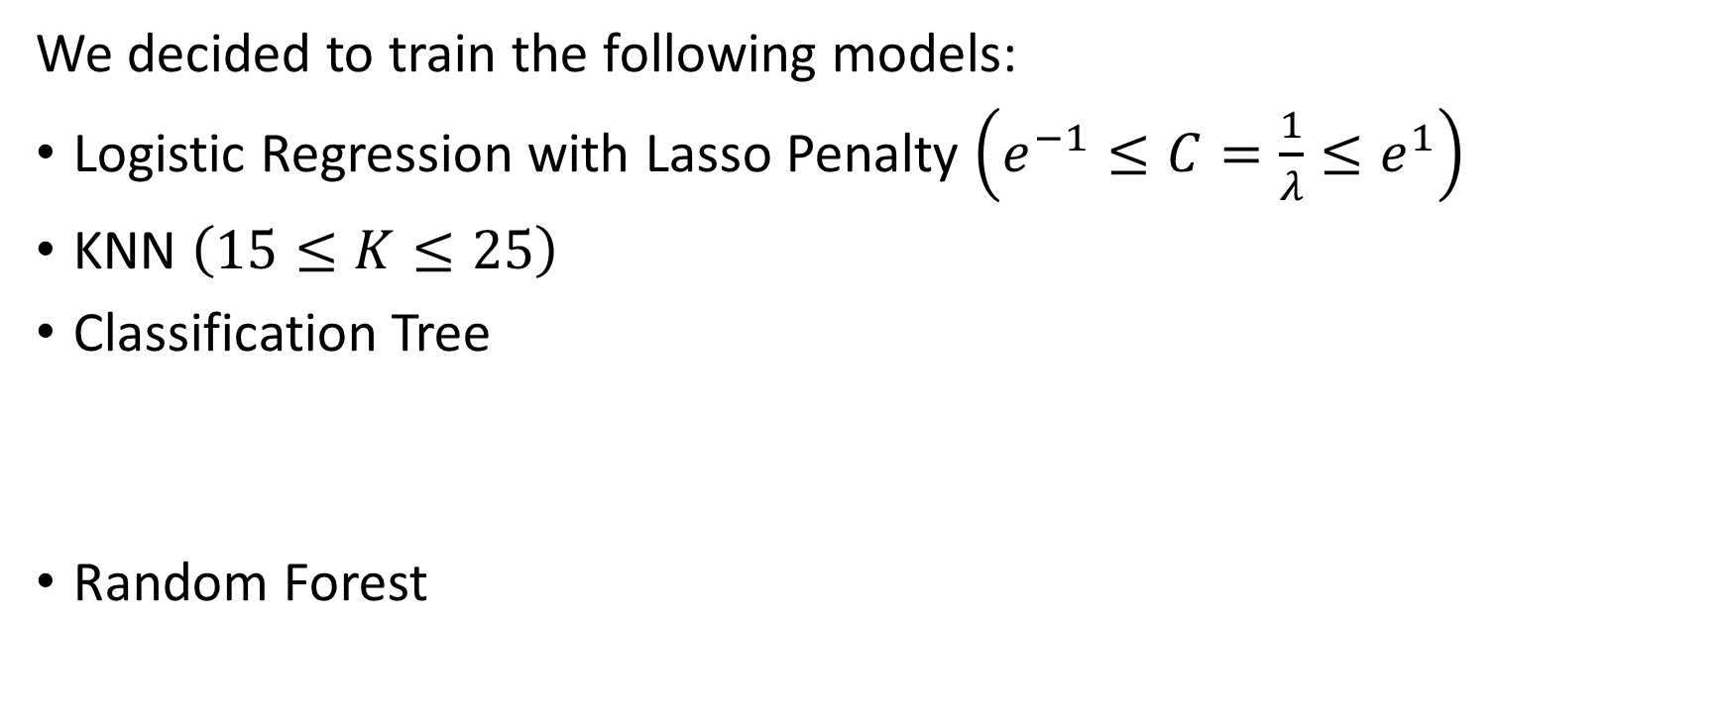
Training The Models
We decided to train the following models:
Logistic Regression with Lasso Penalty $\left(e^{−1}≤C=\frac{1}{λ}≤e^{1}\right)$
KNN $\left(15≤K≤25\right)$
Classification Tree
Random Forest

Slide 18
Training The Models
All the model’s tuning parameters were estimated in 5-fold Cross-Validation and we will show only the best estimators.
We will compare between the method by Accuracy, Sensitivity, Specificity and AUC of ROC curve.

Slide 19
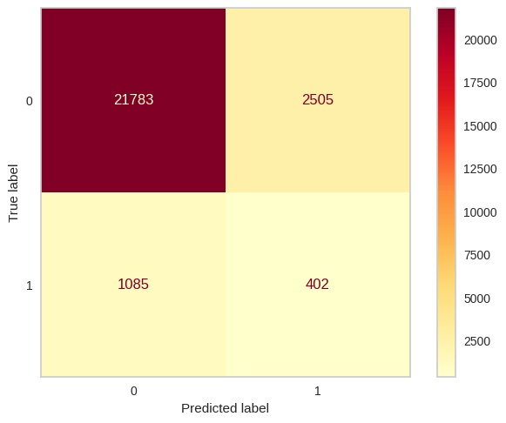
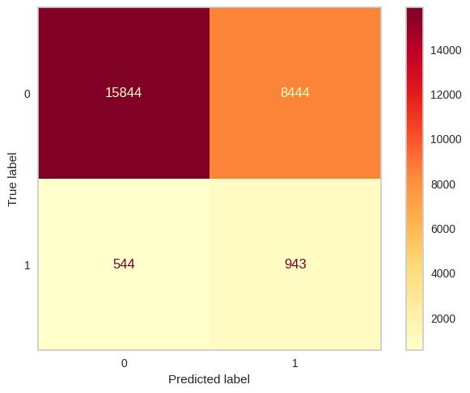
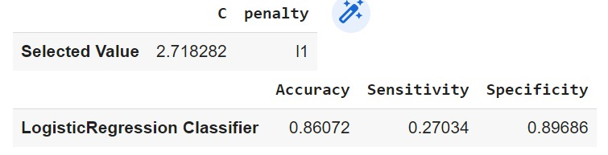
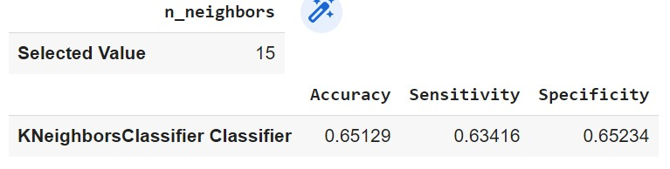
Logistic Regression
KNN

Slide 20
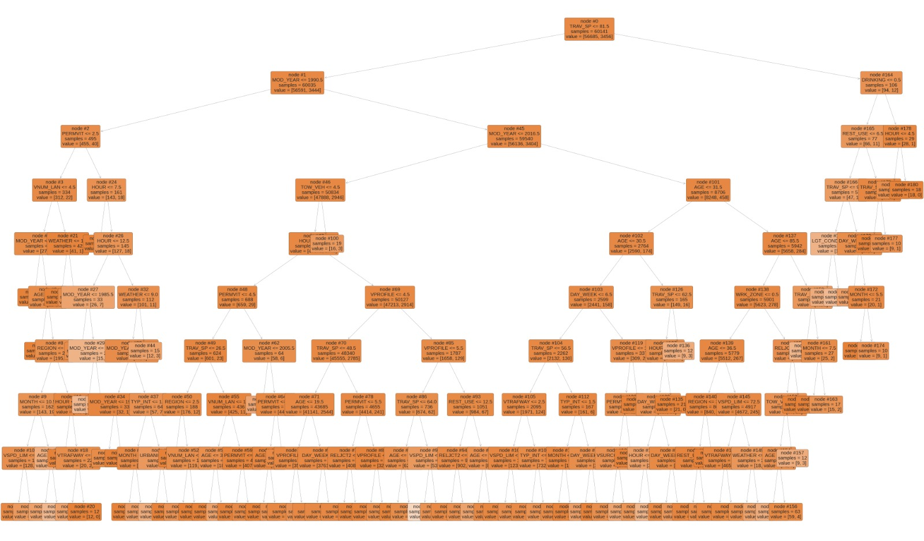
Classification Tree

Slide 21

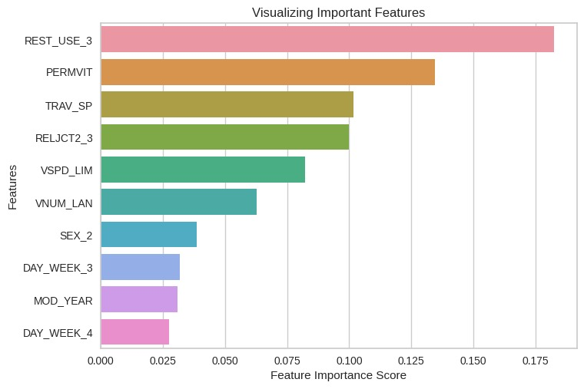



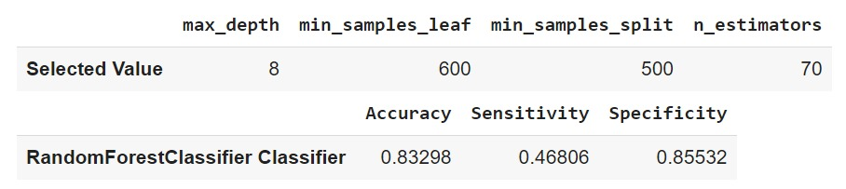
Random Forest

Slide 22
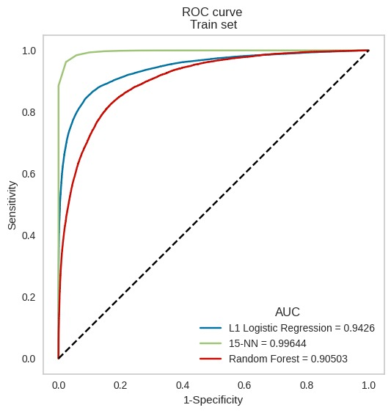
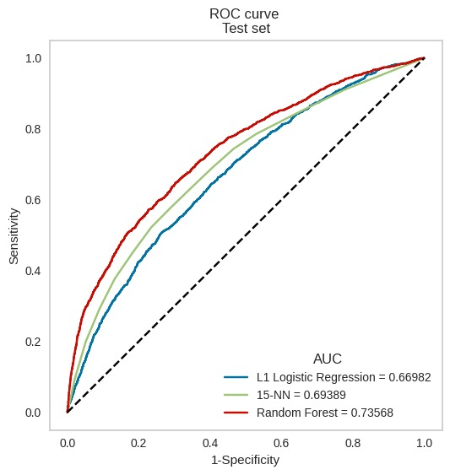
ROC
Notes:
Over-fit מטורף לKNN

Slide 23
Conclusion
We will choose to predict if a driver will be injured by Random Forest model.
Notes:
We did encounter over-fit in the KNN classifier
We didn’t encounter classifier that completely predicted 0 to all observations even though the test data has 94% observations of label 0 and 6% observations of label 1.

